Slide 1


Your Path to Better Health Starts Here

Slide 2
agenda
Introduction
Technologies
Advantages
Future Scope
Conclusion

Slide 3
Introduction
Overview: The MERN (MongoDB, Express.js, React.js, Node.js) stack application revolutionizes the process of booking doctor appointments online, streamlining the entire experience for users and medical professionals alike.
User-Friendly Interface: With a sleek and intuitive user interface built using React.js, users can effortlessly navigate through the application, browse available doctors, and schedule appointments with just a few clicks.
Seamless Appointment Management: Doctors gain unprecedented control over their schedules with real-time visibility into their appointment bookings. They can efficiently manage their time, view upcoming appointments, and make adjustments as needed, enhancing productivity and patient care.
Secure Payment Processing: The integration of Stripe payment gateway ensures secure and seamless transaction processing, allowing users to make payments for appointments with confidence. This robust payment solution offers a frictionless payment experience while safeguarding sensitive financial information.
Scalable Architecture: Leveraging the power of the MERN stack, the application boasts a scalable and flexible architecture that accommodates future growth and expansion. Whether it's accommodating a growing user base or introducing new features, the application architecture remains adaptable and resilient.
Enhanced Healthcare Access: By bringing the booking process online, your application democratizes access to healthcare services, making it more convenient for patients to seek medical assistance and for doctors to manage their practices efficiently. This technological innovation drives positive outcomes by bridging the gap between patients and healthcare providers, ultimately improving healthcare accessibility and delivery.

Slide 4
Live Presentation

Slide 5
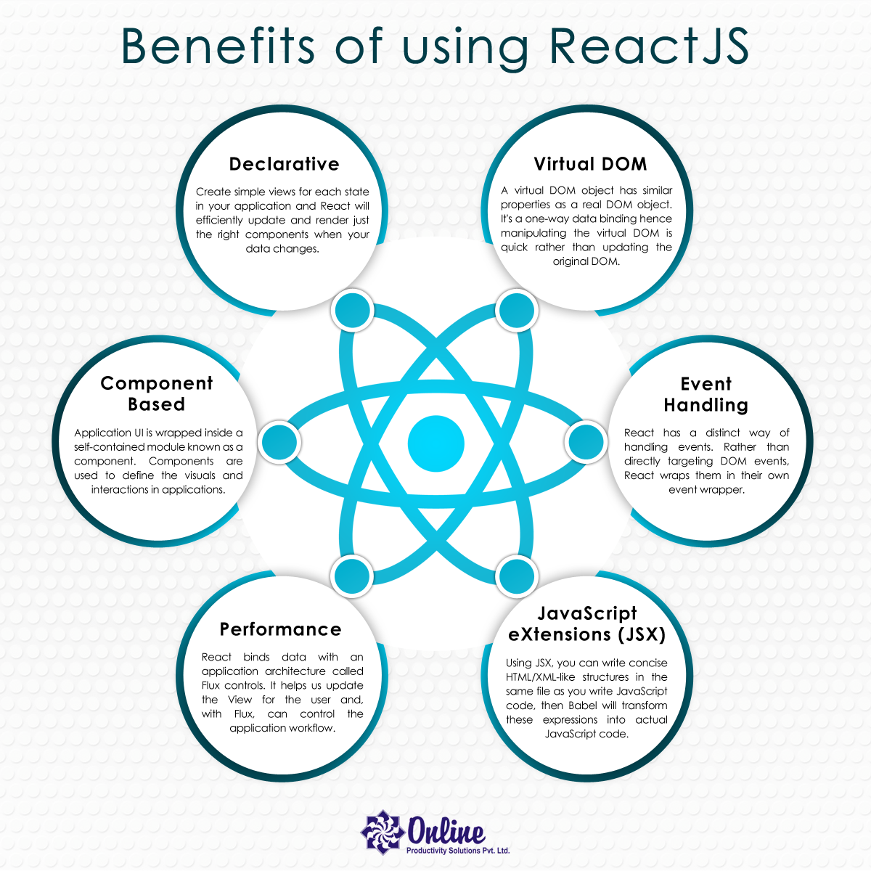
Reactjs
ReactJS is a free and open-source front-end JavaScript library for building user interfaces based on components.

Slide 6
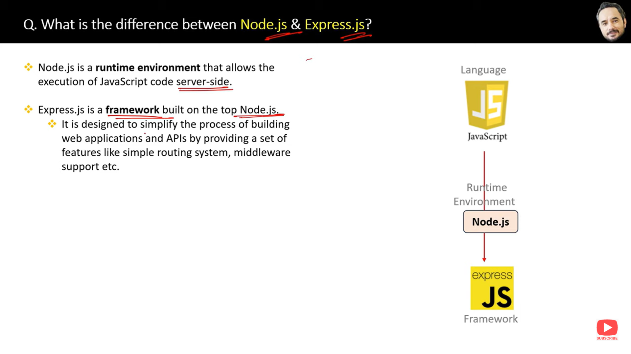
NODEJS

Slide 7
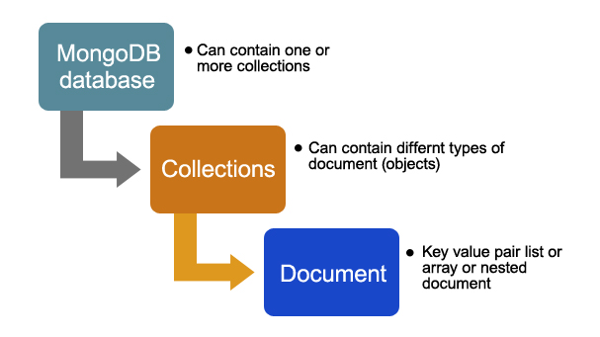

Slide 8
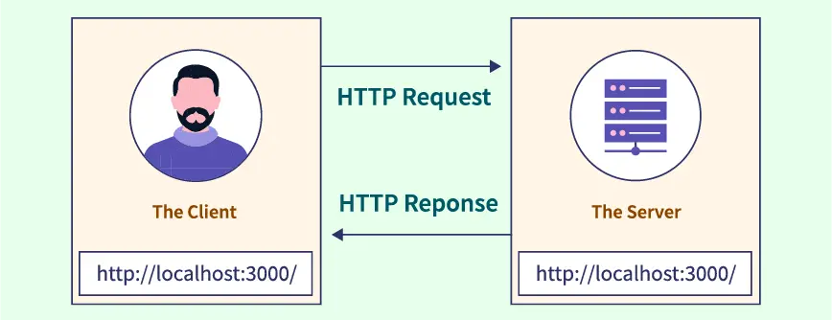
What is CoRS?
CORS is an acronym for Cross-Origin Resource Sharing. As we know, all web applications have a front end & a back end and they communicate with each other via API's. In most cases, both the front end and the back end are hosted on the same origin. CORS in node.js helps to get resources from external servers.

Slide 9
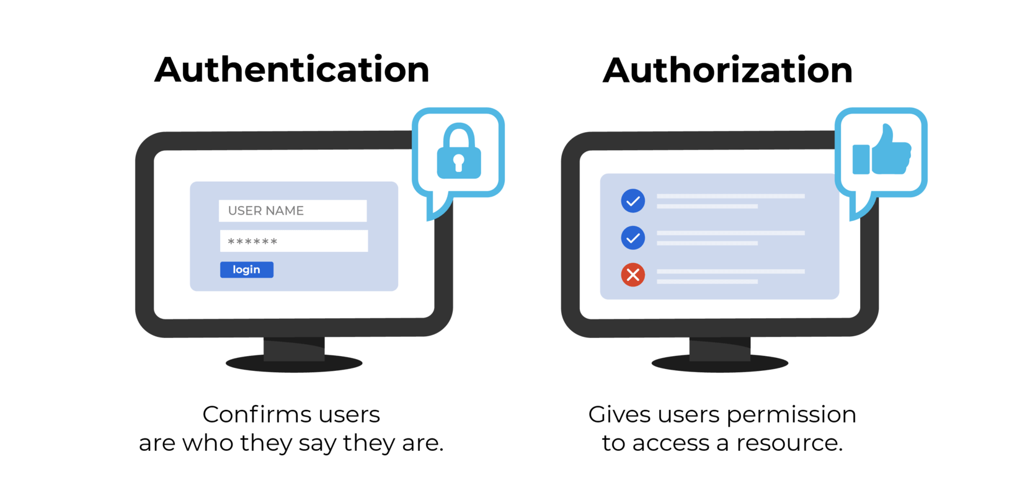

Slide 10
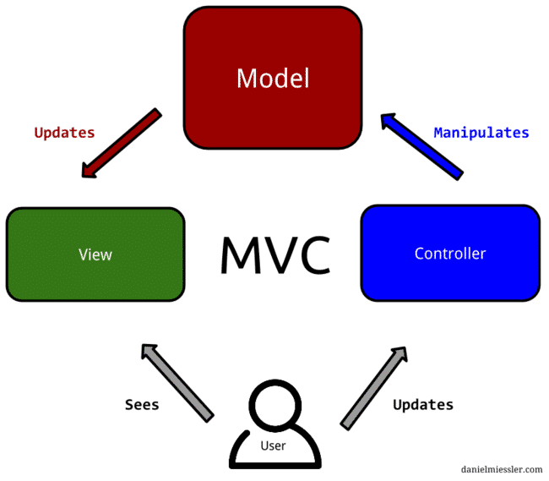
What is controllers?
Controller will have Group of Functions.
It is intermediate between user interface (view) and data model.
It handling User input and updating the model accordingly.
If router is called, then it will connect to functions in the controller.
What is Router?
Routes are the paths that users take to access different parts of your application.
For example, the route /users might lead to a page that
lists all of the users in your application.

Slide 11
A schema is a JSON object that defines the structure and contents of your data.
Mongoose schema defines the document's properties, default values, types of data, validators, etc.
Mongoose model provides an interface for the database to create, query, update, delete records.
JSON Web Token is an open standard for securely transferring data within parties using a JSON object. JWT is used for stateless authentication mechanisms for users and providers, this means maintaining sessions on the client side instead of storing sessions on the server.

Slide 12
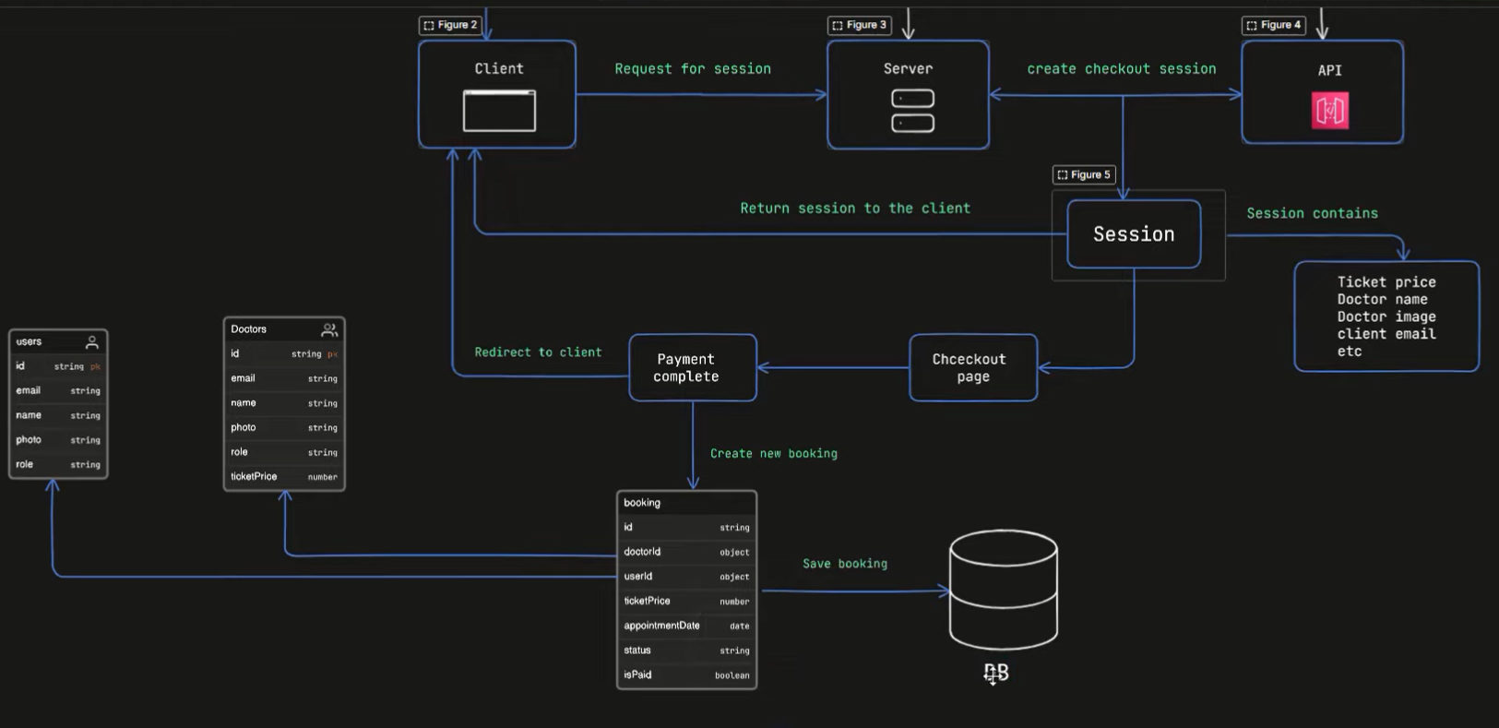
Payment section:

Slide 13

THANK YOU EVERYONE

